Slide 1
CAPSTONE PROJECT Energy Aware Cloud Resource Allocation by using a Novel Negotiation Model NAME:A.MANI BHUMIKA REGNO:192211494 COURSECODE:CSA1585 COURSE:CLOUD COMPUTING AND BIG ANALYTICS FOR BUSINESS

Slide 2
TOPICS
ABSTRACT
INTRODUCTION 1
EXISTING & PROPOSED SYSTEM 2
IMPLEMENTATION 3
FUTURE SCOPE &CONCLUSION 4

Slide 3
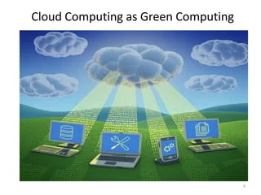
Energy-efficient solutions are required to minimize this energy consumption.

Slide 4
"novel negotiation model" refers to a new or innovative approach to how entities in cloud computing, such as service providers and users, interact and make agreements regarding resource allocation. It signifies a fresh and creative way of negotiating and reaching decisions related to optimizing resource utilization and energy efficiency within the cloud environment. This novel model likely introduces unique strategies or techniques that differ from traditional negotiation methods to enhance the efficiency and effectiveness of resource allocation in cloud computing

Slide 5
ABSTRACT:
In the modern era of cloud computing, efficient resource allocation is paramount to enhance performance while minimizing energy consumption
This paper presents a novel negotiation model aimed at achieving energy-aware resource allocation in cloud environments.
The model achieves an optimal balance between resource utilization and energy efficiency, ensuring that service level agreements (SLAs) are met without compromising performance.
We introduce a multi-agent system where agents represent both CSPs and users.
These agents engage in a continuous negotiation process, utilizing machine learning algorithms to predict resource demands and energy consumption patterns

Slide 6
INTRODUCTION:
ENERGY-aware cloud resource allocation has emerged as a critical area of research aimed at addressing. these challenges.
. Traditional resource allocation models primarily focus on performance metrics such as response time and throughput, often neglecting the energy efficiency aspect.
. In contrast, energy-aware models seek to balance performance requirements with energy savings, thereby reducing the carbon footprint of cloud operations and contributing to sustainability goals.

Slide 7
EXISTING & PROPOSED SYSTEM:
Existing systems and approaches in this domain can be broadly classified into several categories, each with distinct methodologies and optimization techniques:
Static Resource Allocation Models:
Dynamic Resource Allocation Models:
Energy-Aware Scheduling Algorithms:
This model leverages advanced negotiation techniques to facilitate dynamic, real-time interactions between cloud entities, ensuring that resource allocation decisions account for both performance requirements and energy consumption:
Negotiation Agents
Energy-Aware Metrics
Adaptive Algorithms

Slide 8
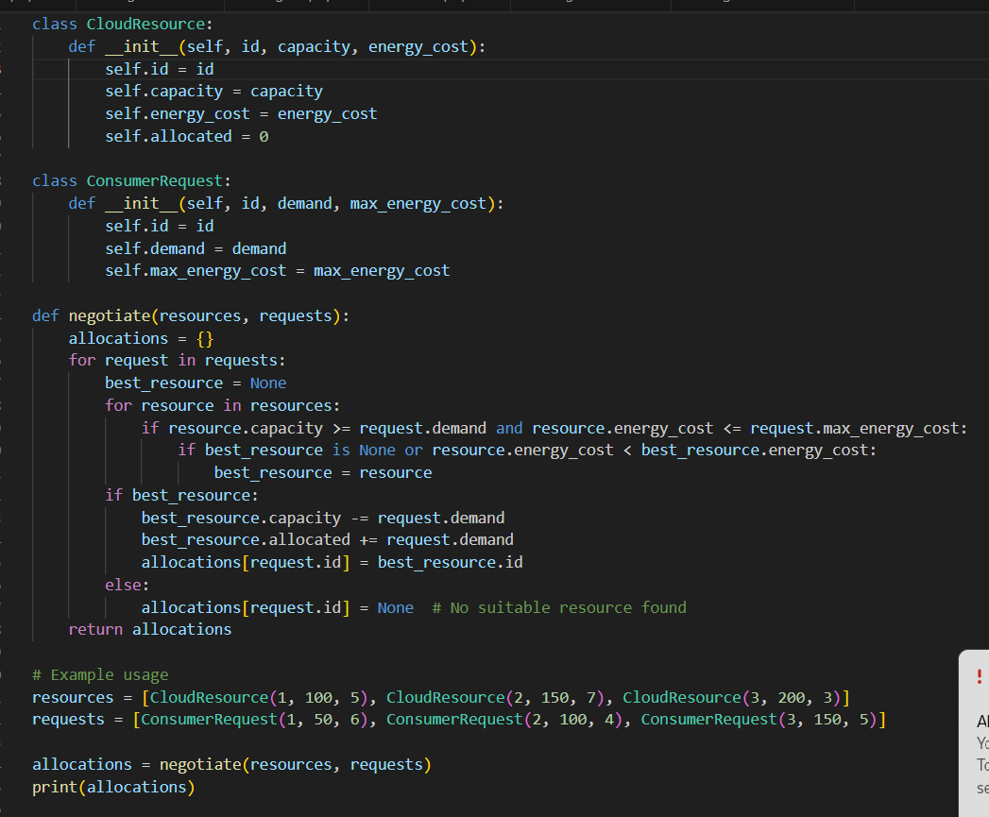
IMPLEMENTATION:

Slide 9

Output:
{1: 3, 2: 3, 3: None}

Slide 10
Future scope:
The future scope for energy-aware cloud resource allocation using a novel negotiation model is both vast and promising, encompassing several key areas for development and improvement.
Integration of advanced machine learning and AI techniques stands out as a crucial direction, where predictive analytics and autonomous negotiation agents can significantly enhance decision-making accuracy and efficiency.
. This includes developing comprehensive metrics that account for environmental impacts such as carbon footprints.

Slide 11
Conclusion:
The implementation of a novel negotiation model for energy-aware cloud resource allocation represents a significant advancement in cloud computing.
The future scope of this research includes the incorporation of AI and machine learning for predictive analytics, the use of renewable energy sources, and the expansion into edge and fog computing.
Ensuring security, reliability, and regulatory compliance further enhances the model's robustness and applicability

Slide 12
thank you
MANI BHUMIKA
1234-098-777
Cloud computing@energyaware.com
www.energyaware.com

